Slide 1

Work-based Learning Wednesday
Fauget Inc.

Slide 2
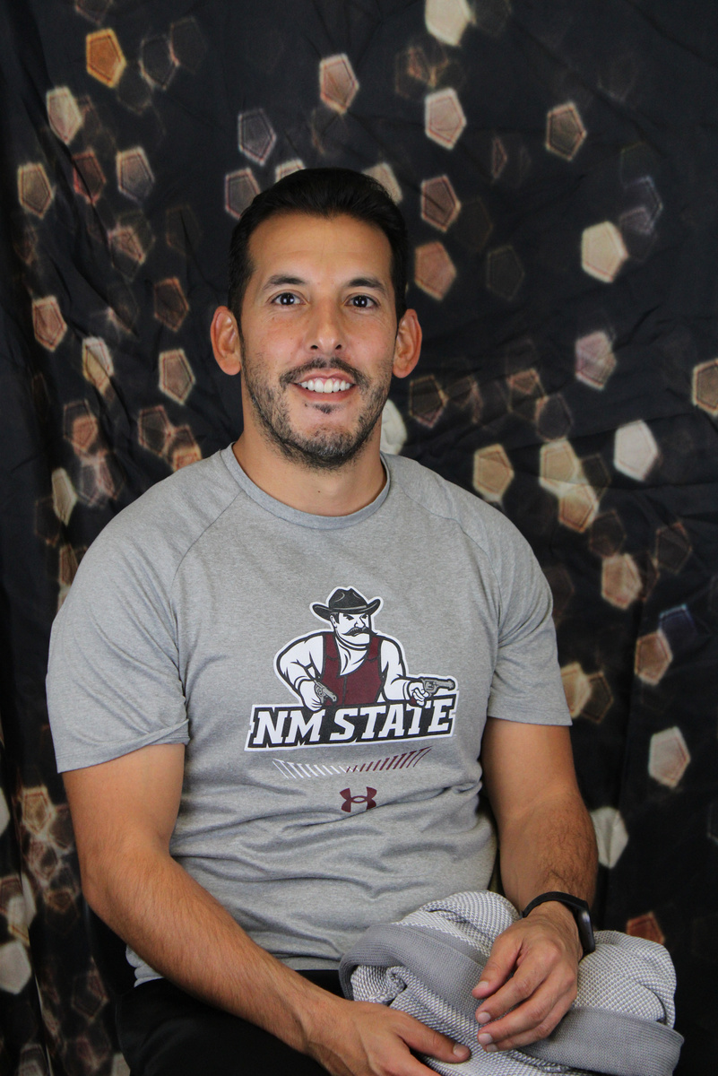
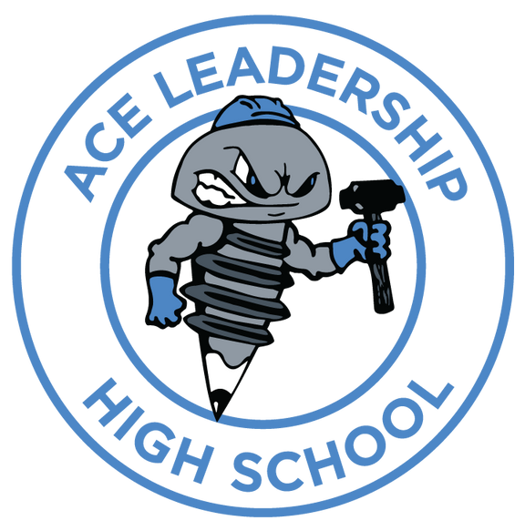
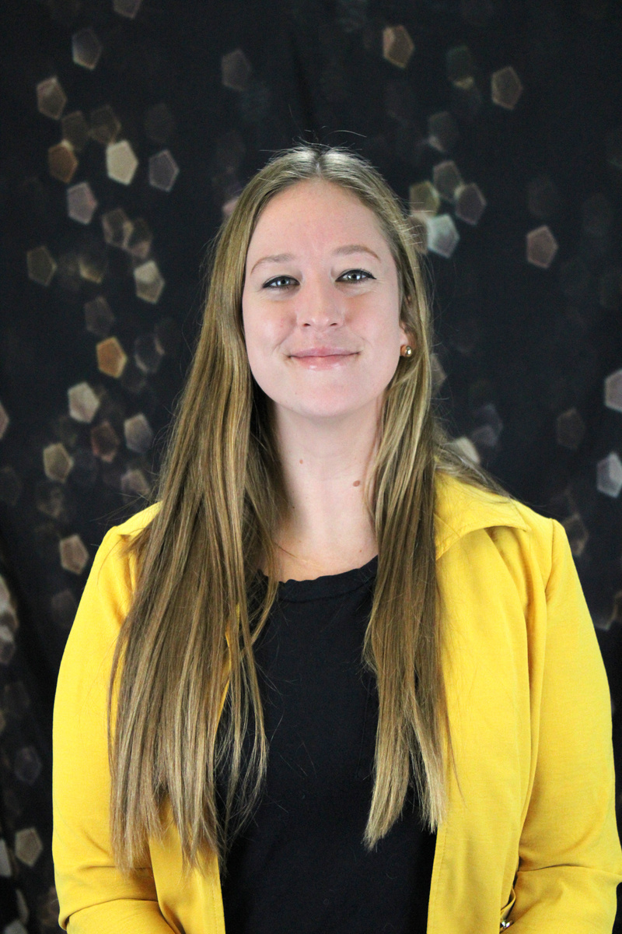
Matthew
Salas
Julie
Jaynes- Pacheco

Slide 3



The How
Targeted spending structure to establish a true Work-based Learning model

Slide 4



Hands on, Learning-by-doing, project-based learning district charter school
rchitecture
Work-based learning embedded in the curriculum and framework of the school
onstruction
Deep history of industry and community partners
ngineering

Slide 5
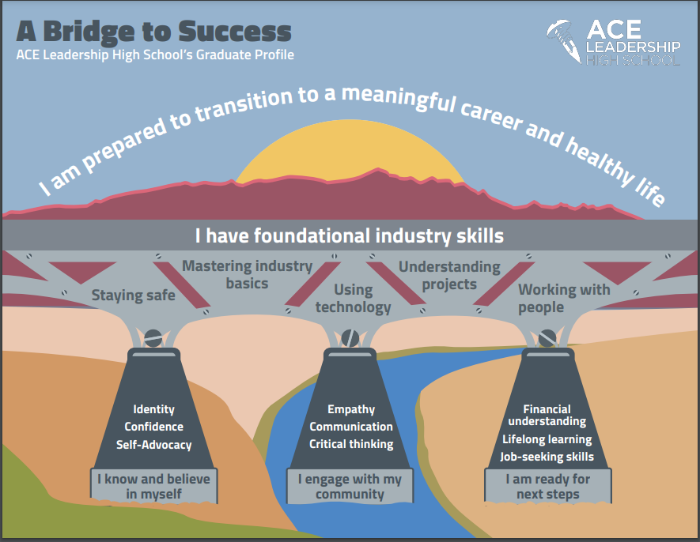
The Why
Learning from all stakeholders

Slide 6
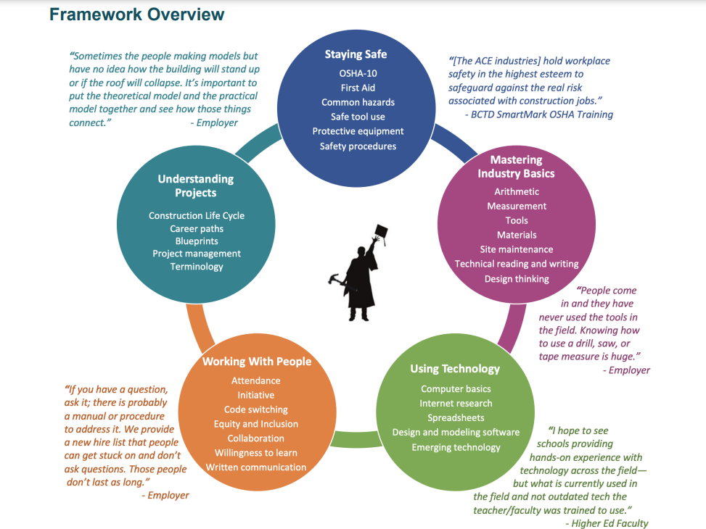
The Why
Learning from all stakeholders

Slide 7
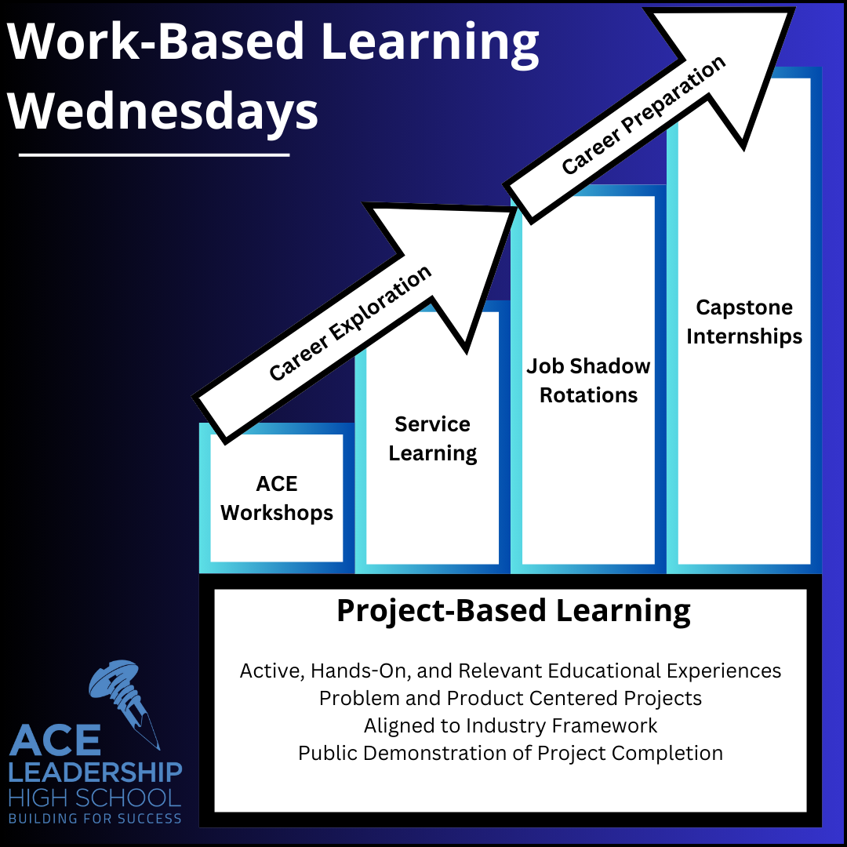
WBL Wednesdays build on ACE’s Project-Based Learning model to offer students additional opportunities for industry skill development, career exploration, career preparation, and soft skill development.

Slide 8
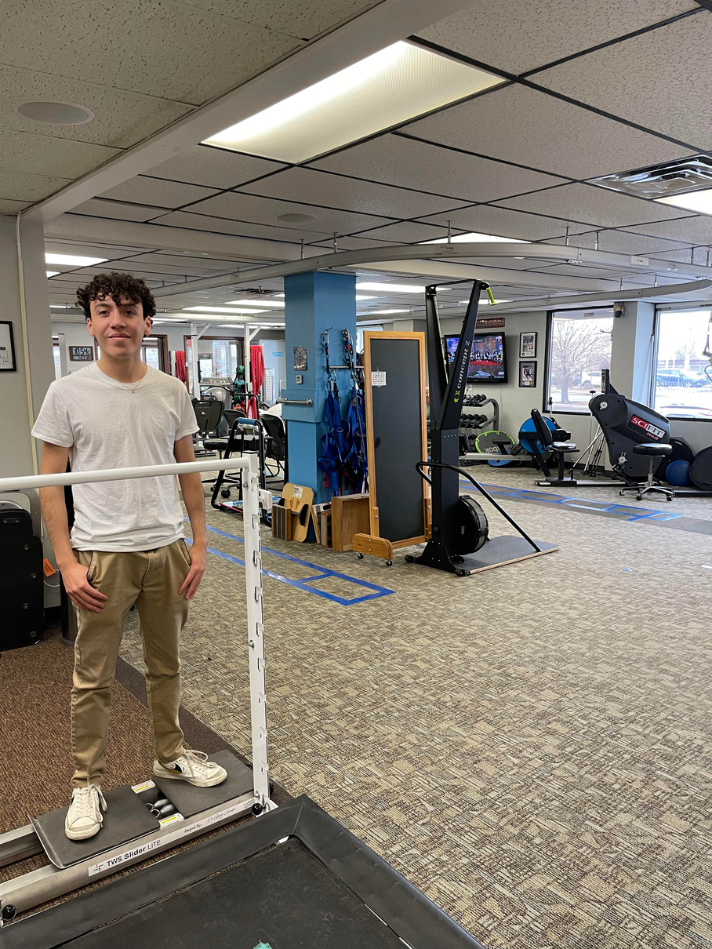
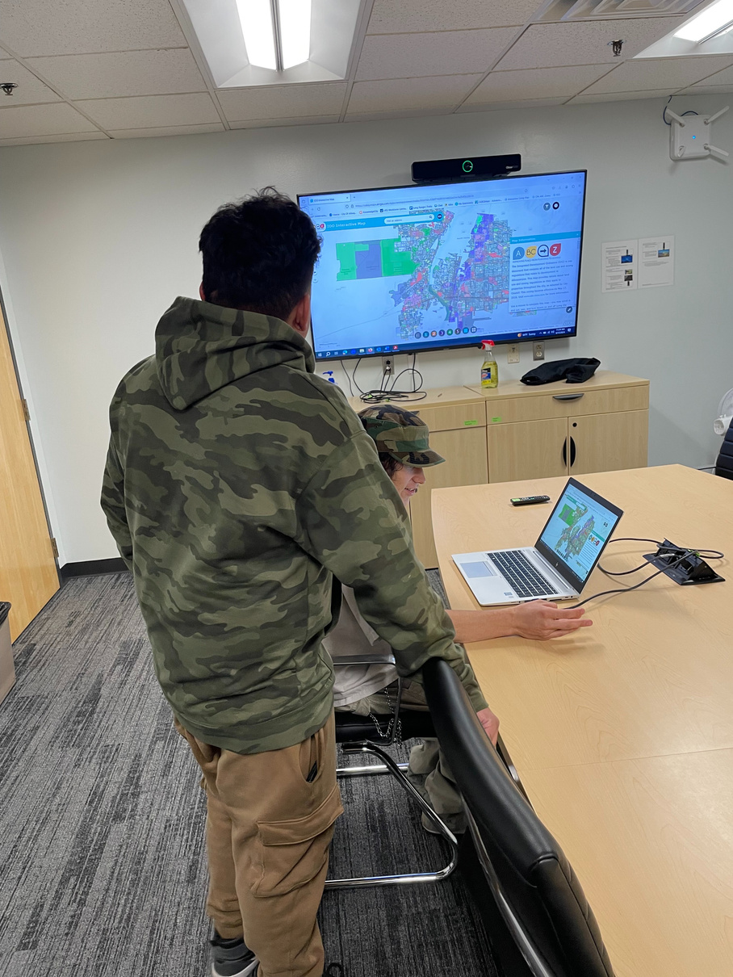
Capstone at ACE
In their final year at ACE, students participate in paid internships to explore career options and build skills while working. Students identify interest areas and work with the Work-Based Learning Coordinator to find a company, organization, or government agency that would be a good match.
23-24 SY Internship Partners
Wayne's Automotive
Painted Sky Elementary
Es Que Market
JB Henderson
Gonzalez Construction
S&S Building Solutions
Lew Wallace Elementary
Echo Inc.
JB Henderson
Active Plumbing & HVAC
CABQ Botanical Gardens
US Electric
La Orilla Farms
US Electric
Roadrunner Food Bank
Rio Grande Food Project
Trucks Unique
Valle de Oro
Lonestar LLC
STA Plumbing
Power Ford
Perpetual Landscape
Equiterra Regenerative Design
Bernalillo County Animal Care
Napa Auto Parts
CABQ Botanical Gardens
Jaynes Corporation
FYZICAL Therapy & Balance Center
Jersey's Plumbing
Corus Health
CABQ YFS Maintenance Department
CABQ Planning Urban Design & Development Division

Slide 9
The What
WBL Wednesday Structures
A snapshot of our model
WBL Workshops
ACE offers a variety of workshops to expose students to different areas of the trades and help build student skills. Workshops include welding, electricity, carpentry, and more.
Service Learning
Students volunteer in small groups at Roadrunner Food Bank, Barelas Senior Center, Locker 505, the Storehouse, and ECHO Inc.
Job Shadow Rotations
Students explore different career areas by shadowing with community and industry partner organizations.
Capstone Internships
In their final year at ACE, students participate in paid internships to explore career options and build skills while working.

Slide 10
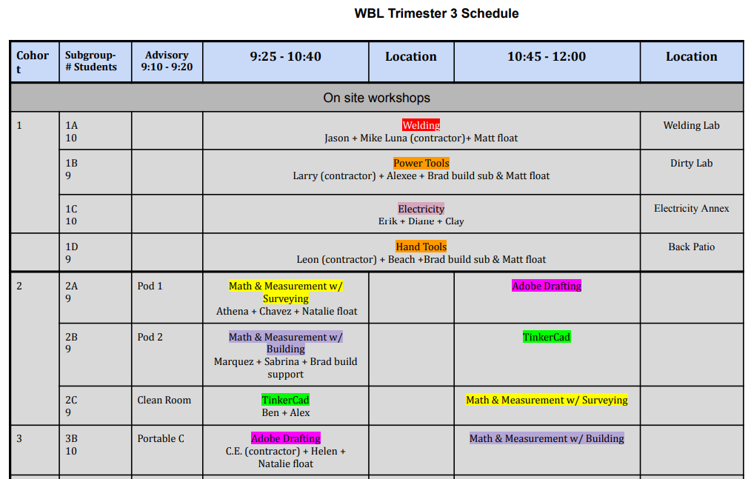
The What
A snapshot of our model

Slide 11
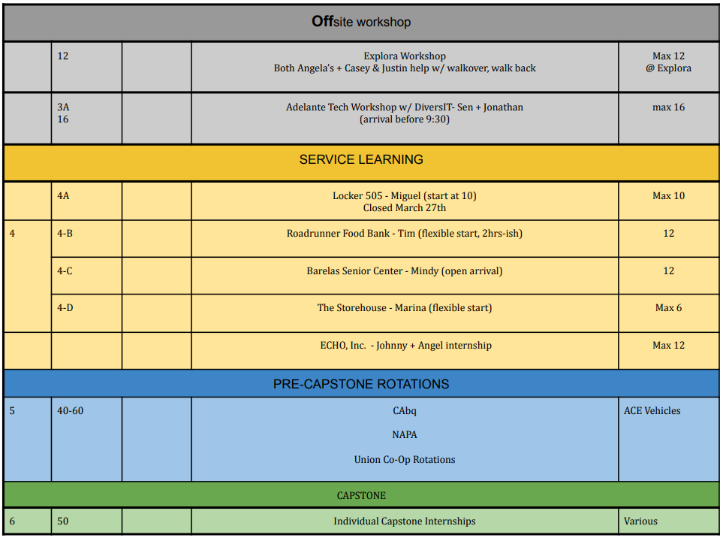
The What
A snapshot of our model

Slide 12
How do we prepare our students for Capstone Internships?
Activity Structure | Student Outcomes
WBL Workshops ACE offers a variety of workshops to expose students to different areas of the trades and help build student skills. Workshops include welding, electricity, carpentry, and more. | Career Exploration Specific Skill Development
Service Learning Students volunteer in small groups at local non-profits like Roadrunner Food Bank, Barelas Senior Center, Locker 505, the Storehouse, etc. | Career Exploration Soft Skill Development
Job Shadow Rotations The Job Shadow Rotation model is designed to provide students with in-depth career exposure opportunities. Small groups of students are placed with professional partners and rotate through their various departments over the course of several weeks. | Career Exploration Soft Skill Development Career Preparation

Slide 13
Adapting These Models To Your Context
  Why are you interested in supporting Work-Based learning?
  What student outcomes do you hope to achieve with this work?
  What assets in your community can support your Work-Based Learning initiatives?

Slide 14
Adapting These Models To Your Context
How can you adapt any of these examples to offer work-based learning opportunities in your context?
Discuss with the people around you.

Slide 15
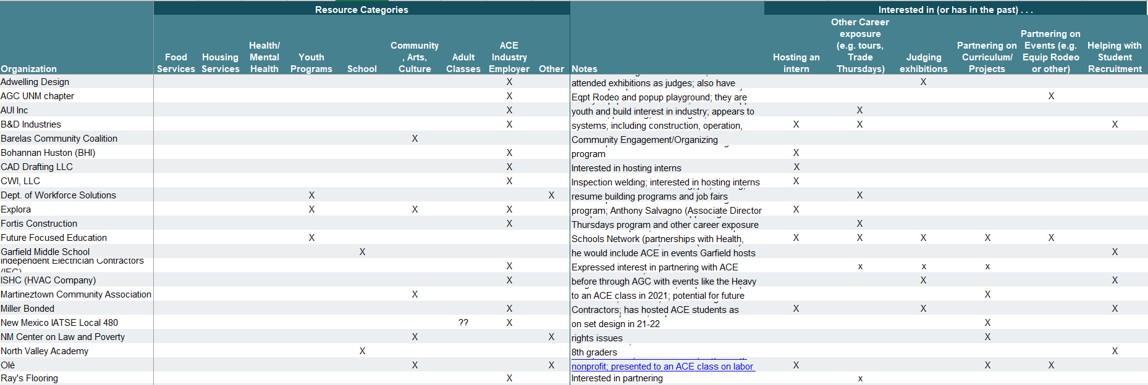

Slide 16
Thank you!
Questions?

